Slide 1

Diego Fernando Montaño Pérez A01282875
Análisis y diseño de algoritmos (1)
Reto Semestral
Ronda 3
Fecha limite: 09/04/2019

Slide 2
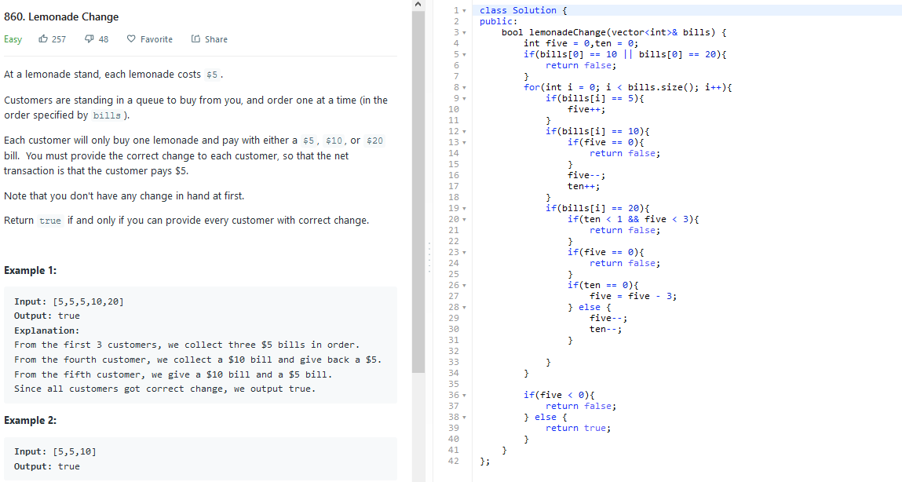
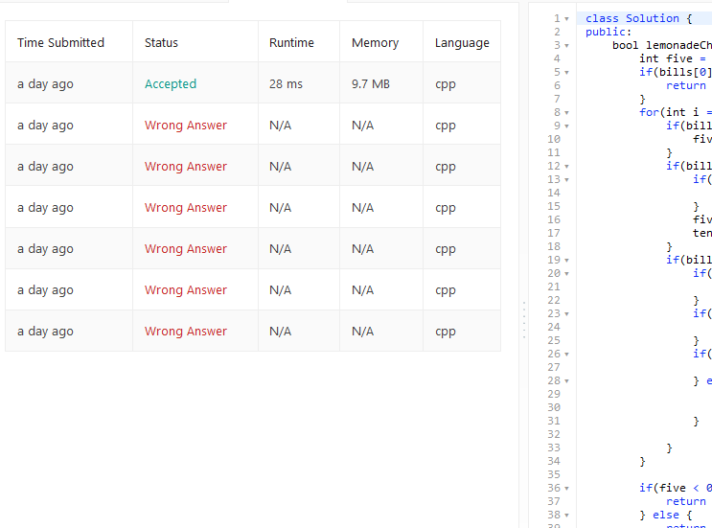
860. Lemonade Change (Greedy-easy)

Slide 3
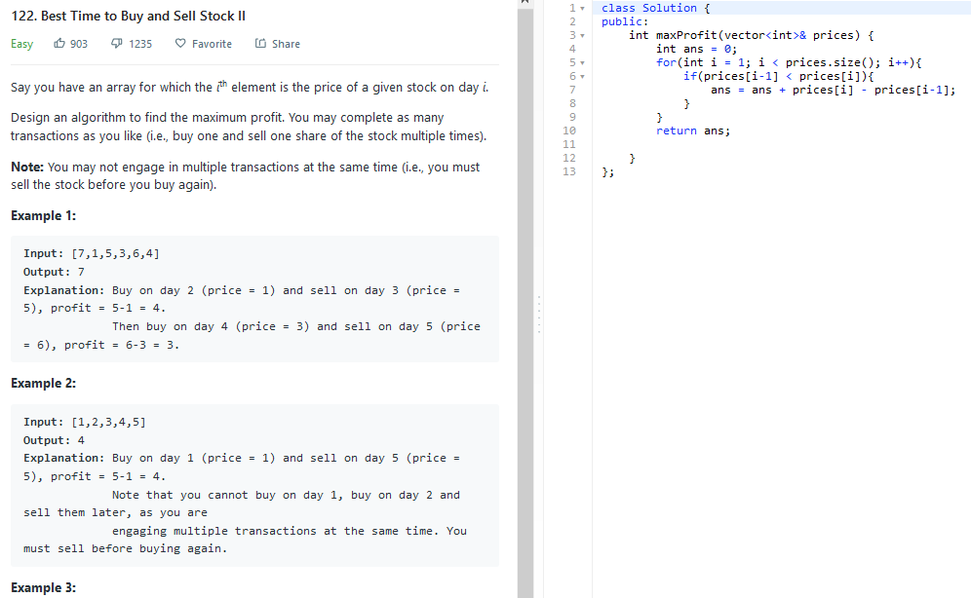
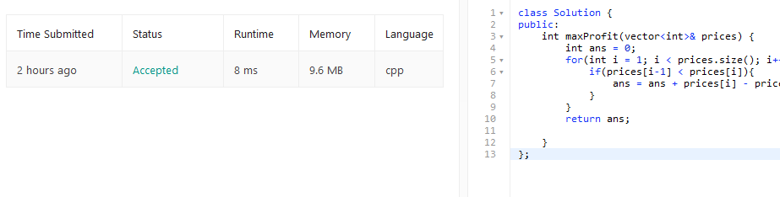
122. Best Time to buy and sell stock ii (Greedy-Easy)

Slide 4
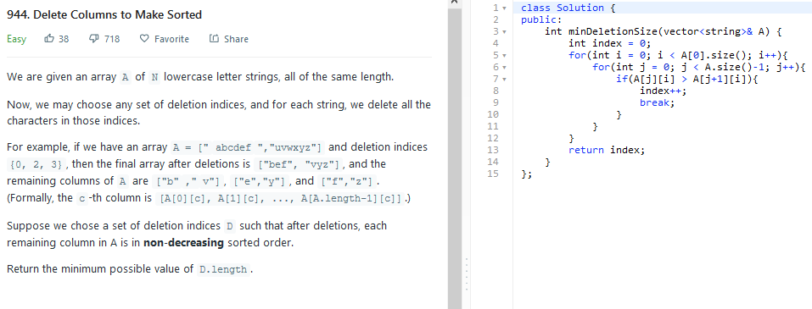
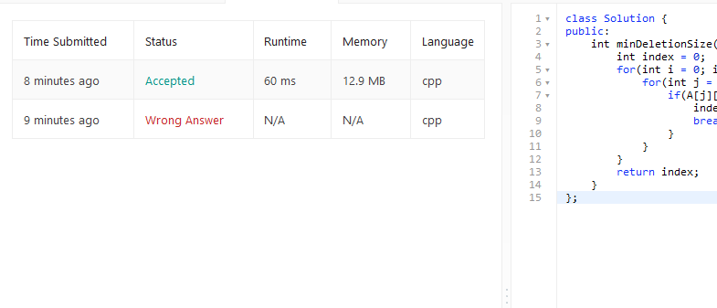
944. Delete columns to make sorted (greedy-easy)

Slide 5
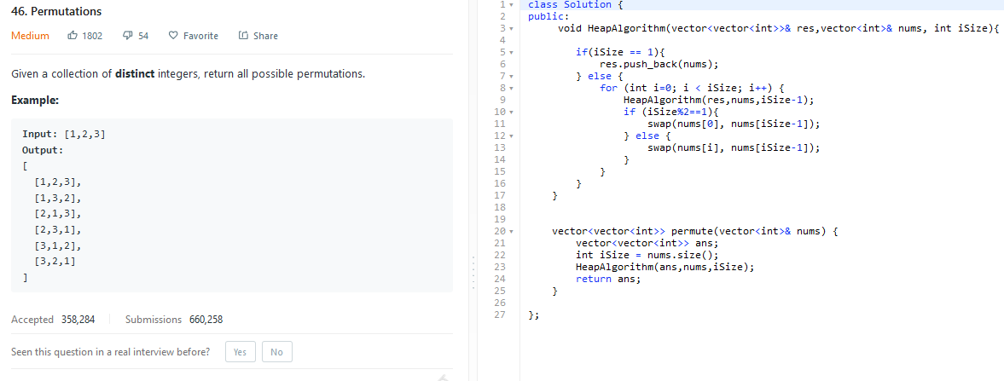
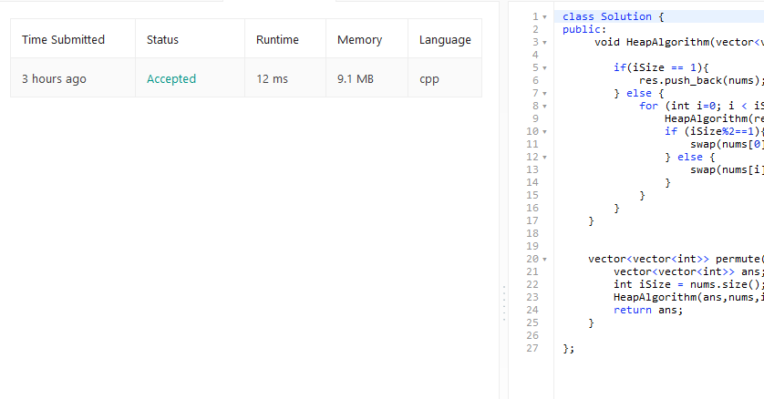
46. Permutations (backtracking-médium)

Slide 6
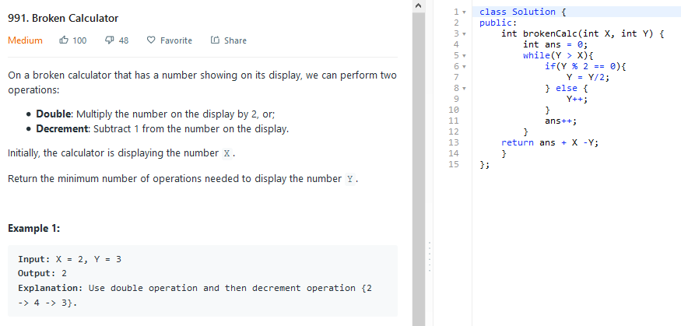
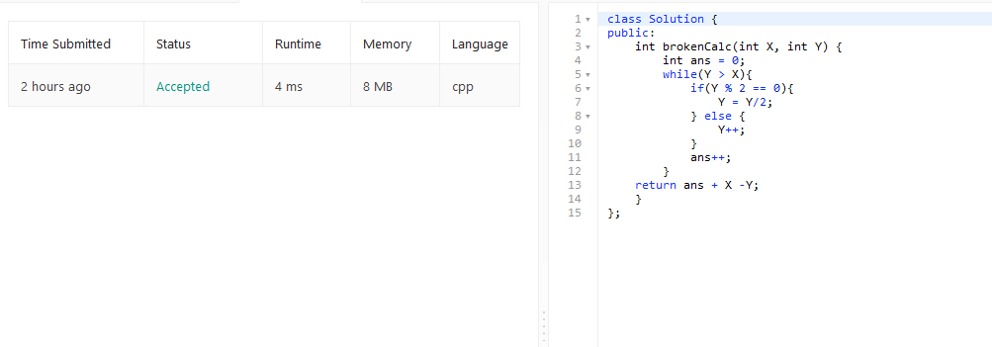
991. Broken calculator (greedy-médium)

